Slide 1
2nd Pollinator Health Task Force Meeting
Pesticides and Education & Communication
2/26/2020

Slide 2
Welcome and Introductions

Slide 3
Agenda

Slide 4
Approving the Charter

Slide 5
Asian Giant Hornet and Houdini Fly

Slide 6
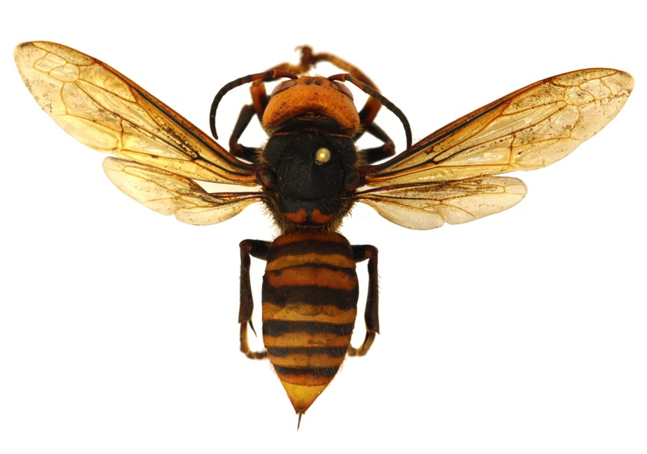
Asian Giant Hornet
Vespa mandarinia Smith, 1852
Asian giant hornet
Japanese hornet
yak-killer hornet
giant sparrow bee
One of ~23 species of “true” hornet, genus Vespa
Palearctic - only Vespa known from NA before is V. crabro, established in the east
Eusocial – cooperative brood care and nesting
Haplo-diploid: females have 2 sets chromosomes, males only 1

Slide 7
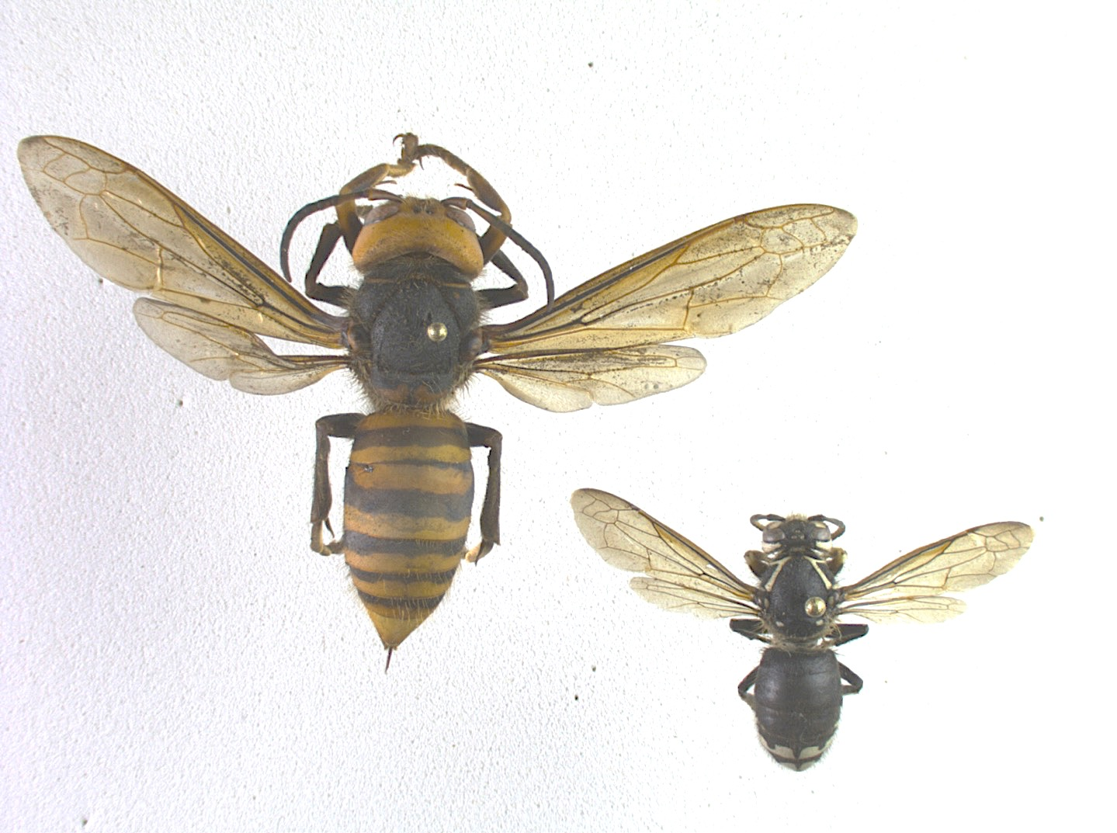
Asian giant hornet (exotic)
Vespa mandarinia
bald-faced hornet (native)
Dolichovespula maculata

Slide 8

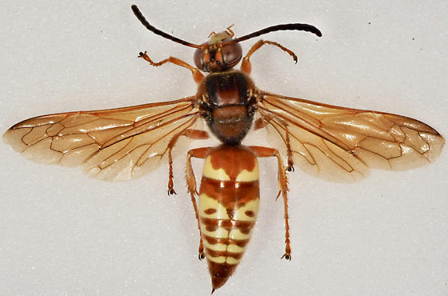
Asian giant hornet (exotic)
Vespa mandarinia
Head slightly wider than thorax
Western cicada killer (native)
Sphecius grandis
Only stripes on abdomen
Head narrower than thorax
Spots and stripes on abdomen
Photo by Ron Johnson, 2018, bugguide.com

Slide 9
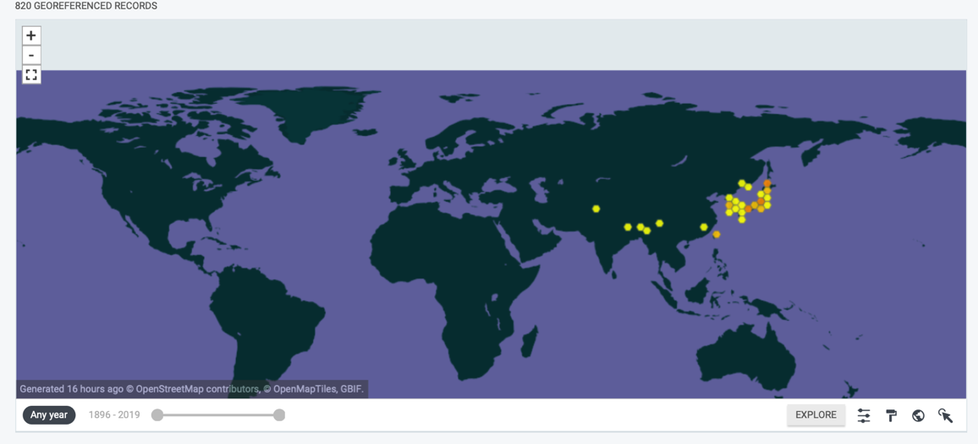
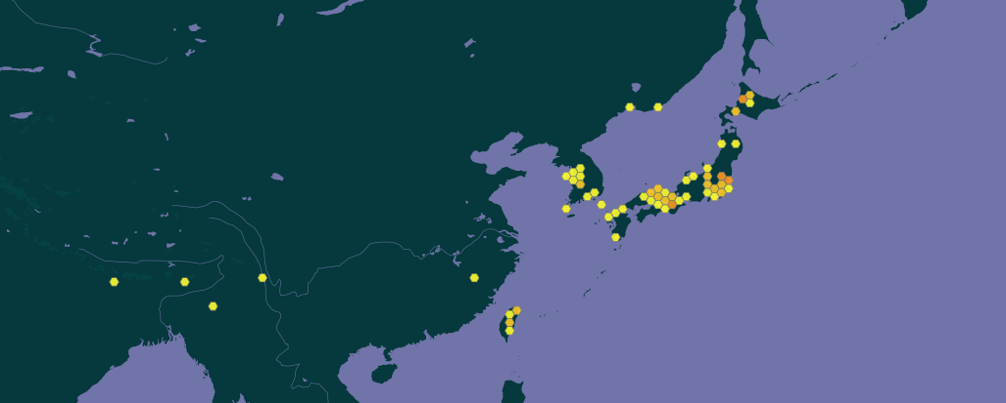
Native range is Asia, most observations in Japan and Korea
Generally subtropic to warm or moderate temperate zones
In 1977 V. mandarinia was limited to southern/central Hokkaido
by 2016 colonies were common ~80 miles/128 km north
data from GBIF.org 2 Jan 2020

Slide 10
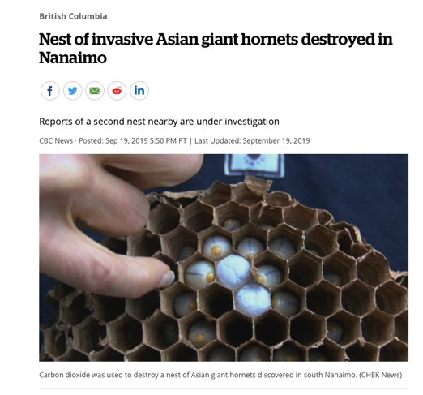
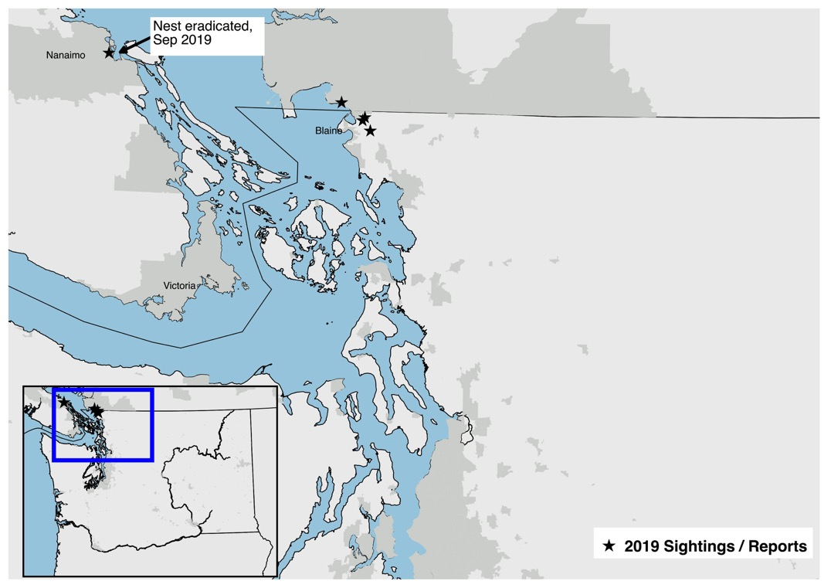
Four wasp sightings in the Pacific Northwest in 2019
One nest located and destroyed in Nanaimo, BC
Possible bee kill in Custer, WA
Report of attacks at hives in Bellingham, WA
www.cbc.ca

Slide 11
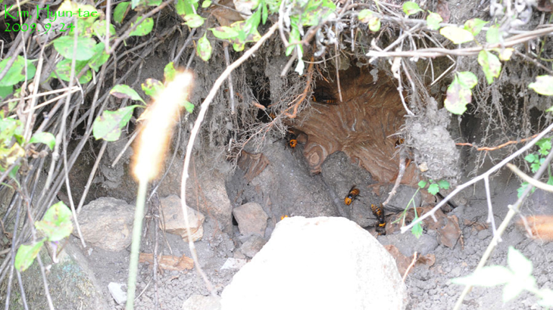
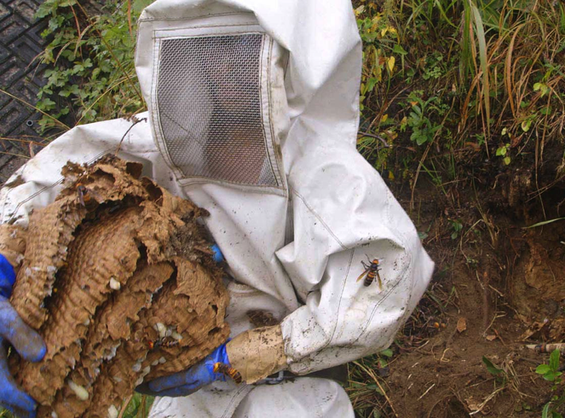
Nesting Habits
Usually underground nests in hollows formed by rotting pine roots, hollow trunks, and rodent burrows (Matsuura & Sakagami 1973)
Very rarely recorded above ground in hollow trees (Yamane & Makino 1977) and human structures (Matsuura & Koike 2002)
Nests can be more than 2 feet/61 cm wide and contain hundreds of adult hornets
Prefer forested habitats
Photo: Kim, Hyun-tae
Photo: still from Bugs the film

Slide 12
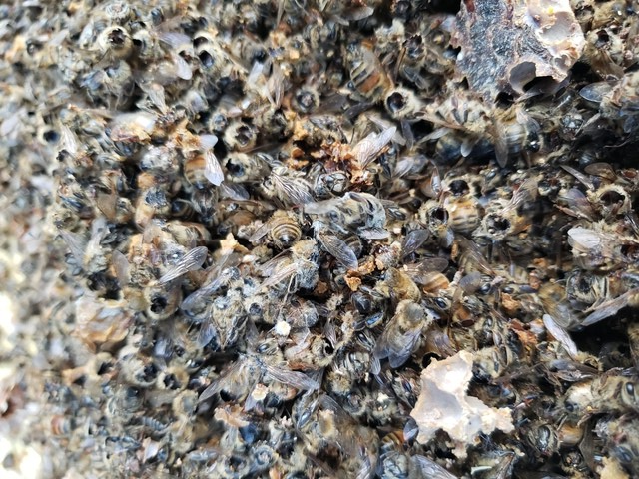
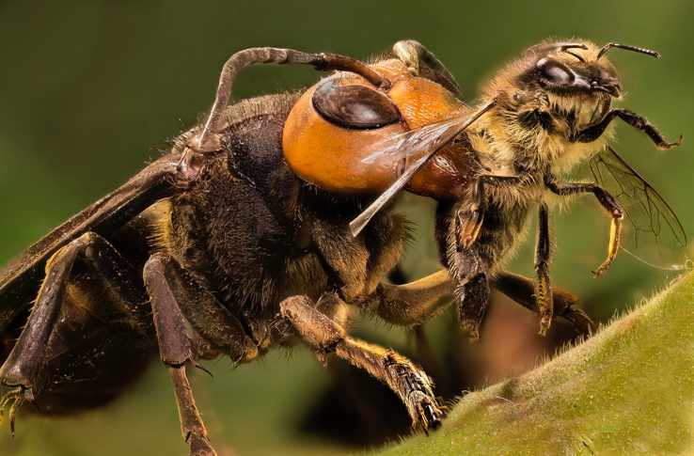
Foraging Habits
Emerged queens feed on carbohydrates, mostly sap
Workers acquire protein from insects, feed to larvae
Attack scarab and longhorn beetles, other large insects, and honey bees
Workers forage nearly 5 miles/8 km from their nests (average 1 mile/ 2km)
Photo: unknown
Photo: T. McFall

Slide 13
Foraging Habits
Honey bee attacks have three distinct stages
Hunting phase: Individual hornets catch bees, form a “meat ball” from the bee thorax, and return it to their nest
Slaughter phase: One hive is the focus. Hornets capture adult bees, kill them, and dump the bodies. Hornets will vigorously defend attacked hives during this phase.
Occupation phase: Hornets wander the hive at will, select pupae and larvae, and return them to their own nest for food
As few as 20 hornets can functionally destroy a bee hive in 1-6 hours
from Matsuura & Sakagami 1973

Slide 14

Human Health
Venom impacts are similar to other Hymenoptera - but can be a little worse
Localized tissue necrosis and massive pain are the most likely outcomes of a sting
Anaphylactic shock is always a risk from stinging Hymenoptera
V. mandarinia delivers large doses, but typically sting only when handled, defending the nest, or defending a hive they are attacking
Mass attacks are very rare, but in extreme cases can cripple or even kill victims
Treat stings with cold to slow venom spread, and seek medical attention if you are stung multiple times or have signs of an allergic reaction
This photo shows an extreme example of venom
damage from a rare mass stinging event.
Photo: the Guardian

Slide 15
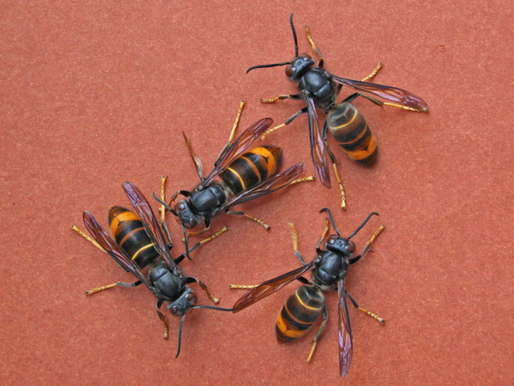
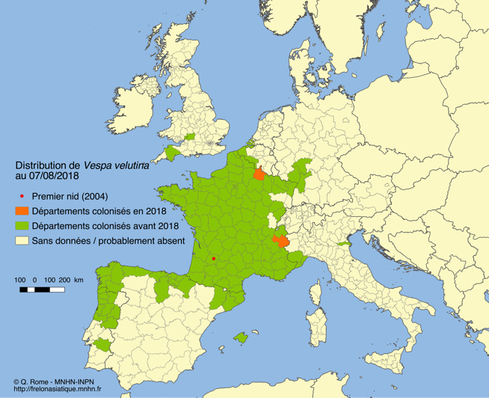
What can we expect?
A similar species, V. velutina, became established in Europe by 2004, in central France
Spreading at about 60km year
At least 2 human deaths (FR)
Some beekeepers report about 2/3 reduction in honey, 30% hives impacted
Photo: Abellas Hailas

Slide 16
What will we do?
Washington State and British Columbia are exploring response options
Washington State will conduct various types of trapping this spring
Our shared hope is to work with stakeholders in both countries and eradicate this species
In Washington State, please report any suspect sightings to:
WSDA Pest Program: PestProgram@agr.wa.gov
WSDA Pest Hotline: 1-800-443-6684
Online at: agr.wa.gov/hornets
Operators are standing by for your hornet report!
You can also follow our hornet activities on facebook: www.facebook.com/groups/hornets

Slide 17
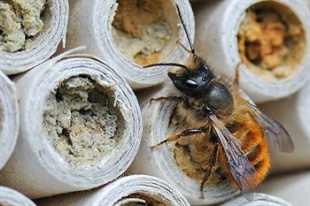
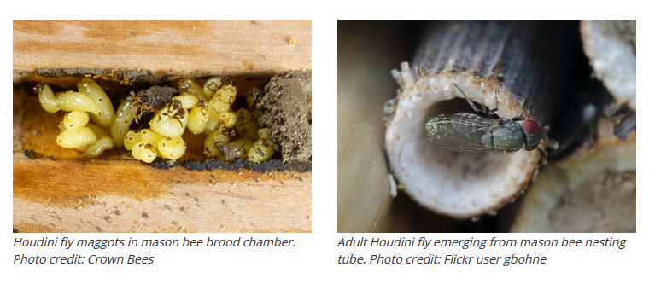
Houdini Fly (Cacoxenus indagator)
European kleptoparasite of mason bees (Osmia spp.)

Slide 18
How to manage Houdini Fly if you have Mason Bees:
Harvest mason bee cocoons – Open mason bee nesting materials before they emerge in the spring and destroy Houdini fly maggots.
Control adult mason bee emergence – If you cannot open nesting materials, place your nesting materials in a fine mesh bag and close tightly. As the bees emerge, release the mason bees daily and kill any Houdini flies.
Only use nesting materials that allow you to open, inspect, and harvest cocoons. Visual inspections can greatly reduce Houdini fly populations.
Only purchase pest-free mason bee cocoons. Before purchasing mason bees, ask the provider how they harvested and whether they inspected the cocoons for Houdini fly.

Slide 19
WSDA Pesticide Compliance with Kevin Jensen

Slide 20
WSDA Pesticide Training with Bradley Farrar

Slide 21
Pesticide Recommendations
Research required category

Slide 22
Education & Communication Recommendations
Education Goals
Outreach Target Audiences

Slide 23
Next Steps
Habitat Meeting – March 16
Managed Pollinator Meeting – April 27
Research Meeting – May 21
Bonus Meeting – June 17
Voting to start August 1st

