Slide 1

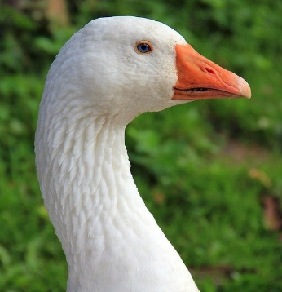
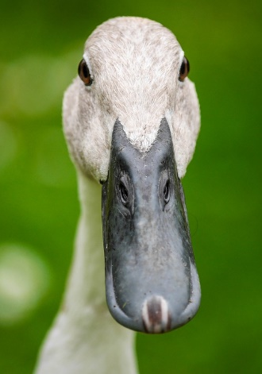
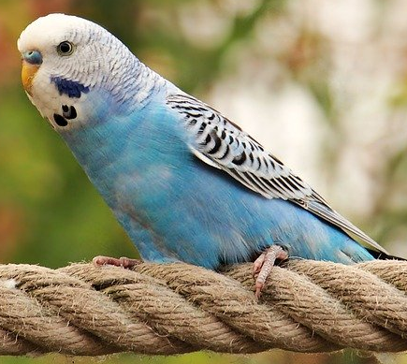
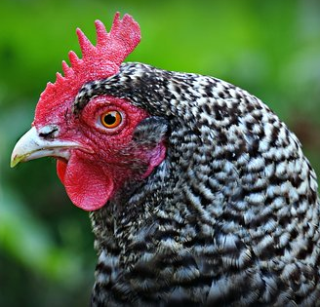
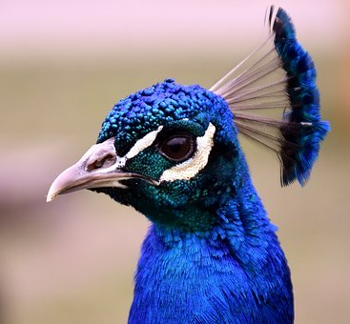
WSDA Avian Health Program Avian Disease Prevention Training Course

Slide 2

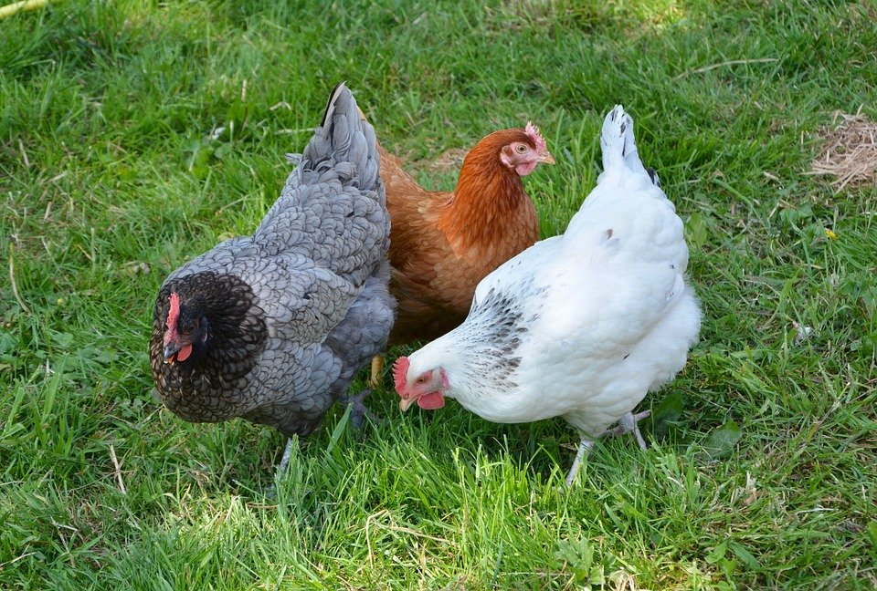
Goal
The goal of this presentation is to provide poultry owners with a basic understanding of avian health terms, concepts, and biosecurity.

Slide 3
Terminology
Pathogen: a bacterium, virus, fungus, parasite, or other agent able to cause disease.
Biosecurity: actions taken to prevent the introduction and/or spread of diseases.
Signs: evidence of illness that can be observed, such as diarrhea or coughing.
Carrier: an animal chronically infected with a pathogen; may or may not appear ill.
Contagious: type of disease caused by an organism that can be spread between animals.
Transmission: spread of disease between hosts.
Zoonotic: disease that can be transmitted between humans and animals.

Slide 4
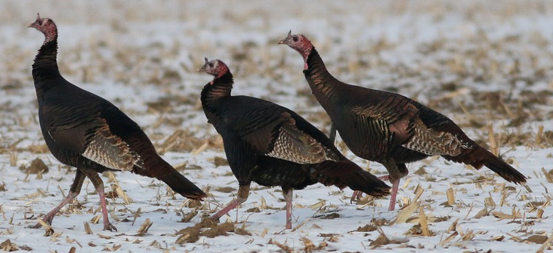
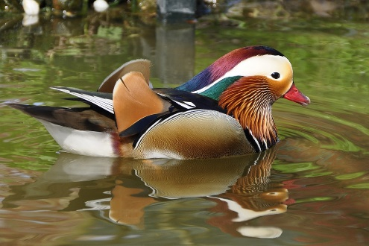
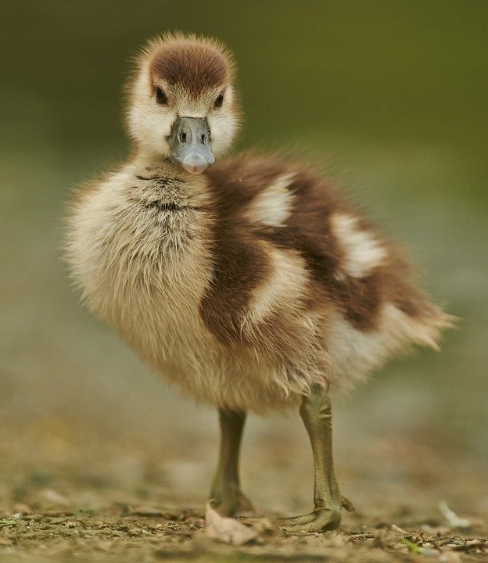
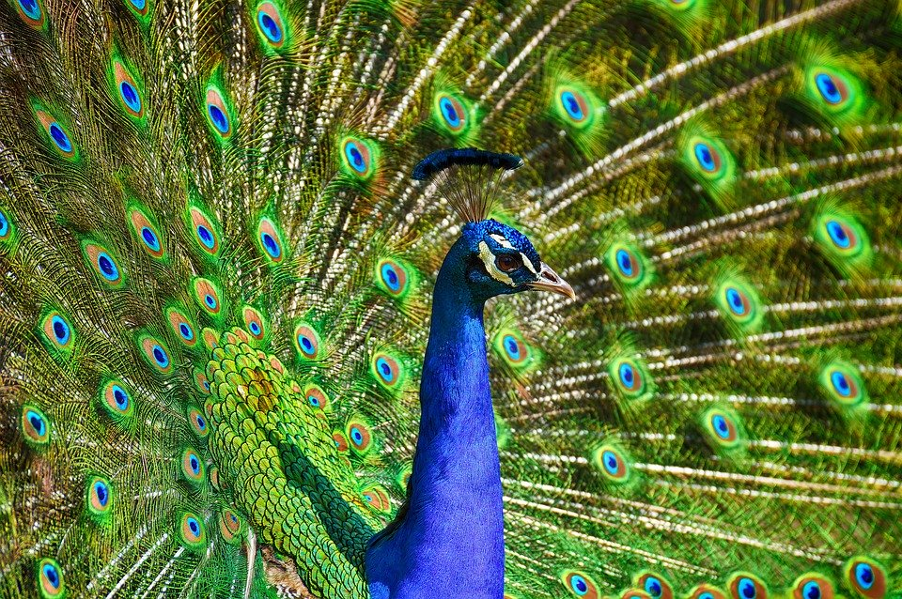
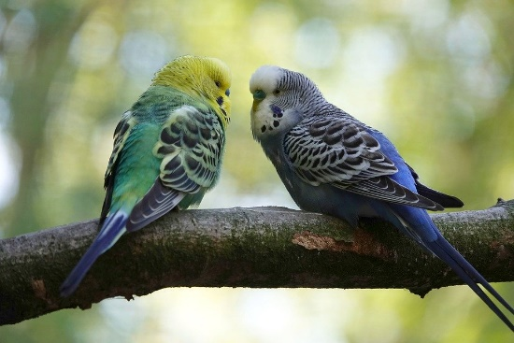
What is a Bird Disease?
Disease is a change from normal health, not including injury.

Slide 5
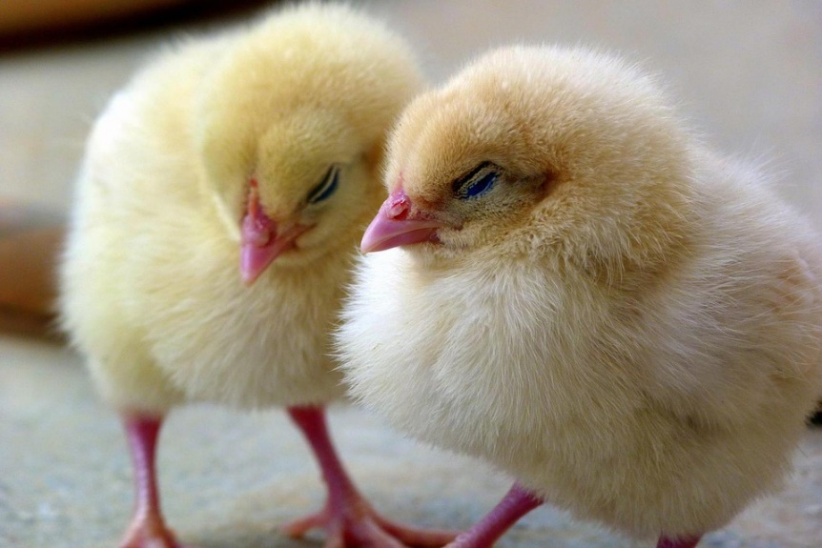
Zoonotic Diseases
Diseases shared by people and animals
Can be transmitted from animals to people and vice versa
Examples:
Salmonella (particular concern with chicks and children)
Avian influenza (some types)
Psitticosis
Erysipelas
Avian tuberculosis

Slide 6
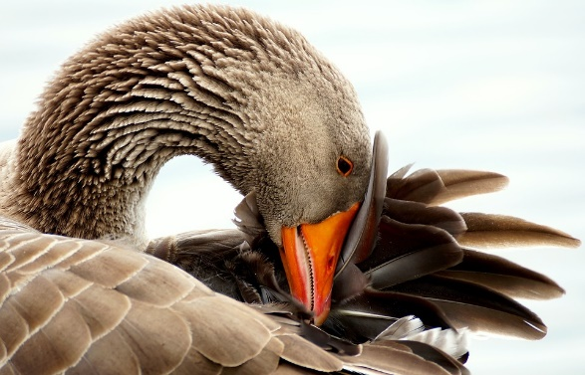
Effects of Disease
On Birds
Reduced egg production
Increased death loss
Decreased growth rate
Diminished animal welfare
Diminished activity and body functions (flying, roosting, foraging, etc.)
On Producers
Reduced farm profitability
Reduced product quality
Increased expenses
Restrictions on sale of birds
Damage to farm reputation
Reduced enjoyment of hobby

Slide 7
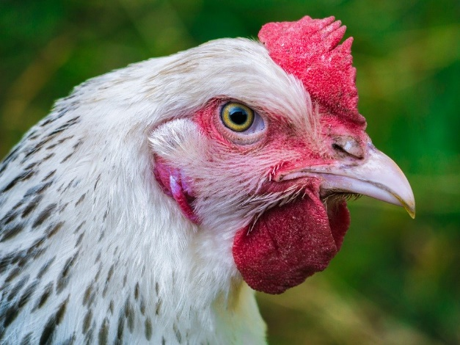
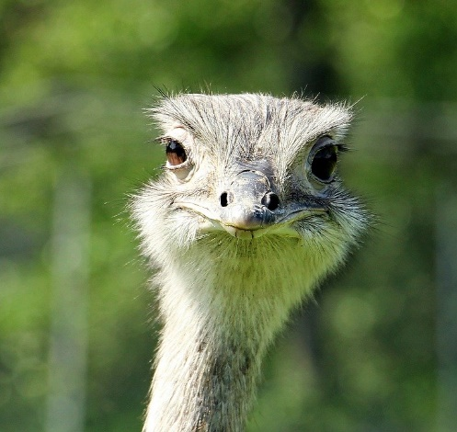
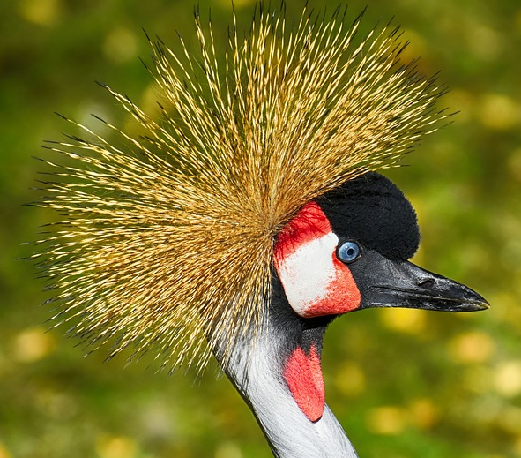
Infectious vs. Non-infectious Diseases
Infectious diseases are contagious and spread between birds
Examples: Avian influenza, virulent Newcastle disease, Marek’s disease
Non-infectious diseases are not spread between birds
Examples: Rickets, botulism, prolapse, egg peritonitis

Slide 8

How Do Diseases Spread?
Direct Contact: contact with a sick bird and/or its wastes, discharges, or secretions
Indirect Contact: contact with objects contaminated by a sick bird or its wastes, discharges, or secretions
Contaminated surfaces
Vectors (mosquitoes, lice, ticks)
Inhalation of aerosolized pathogens
Contaminated human hands, footwear, clothing
Contaminated cages and food and water bowls
Fomites (contaminated inanimate objects like show carpet squares, brushes, clippers, tires, etc.)
Contaminated flies, wildlife, dogs, rodents, etc.

Slide 9
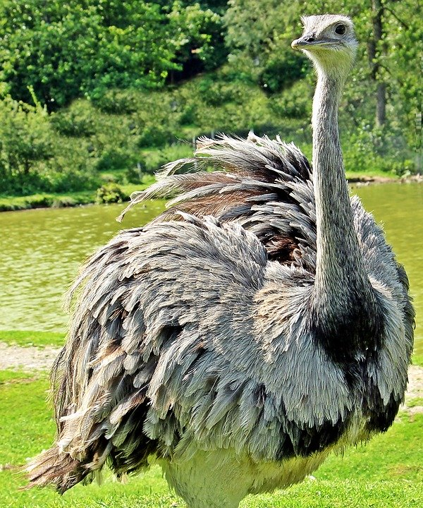
Recognizing Disease Conditions
Disease changes may be subtle:
Know what “normal” or “healthy” looks like for your birds
Early phases of illness can be difficult to recognize
Examine birds daily for signs of illness such as sneezing, coughing, and reduced feed or water intake
Birds may appear healthy, but may be carrying disease agents or in early stage of illness

Slide 10
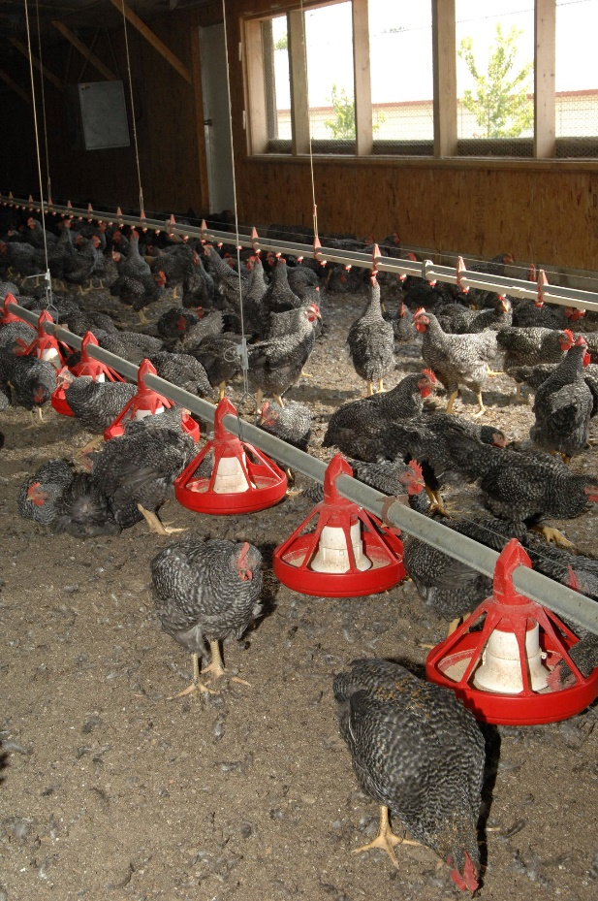
Poultry Pathogens
Infectious diseases are caused by:
Bacteria
Salmonella Pullorum-Typhoid
Mycoplasma gallisepticum
Viruses
Avian influenza
Marek’s disease (herpes)
Virulent Newcastle disease
Fungi
Aspergillosis
Parasites
USDA APHIS

Slide 11
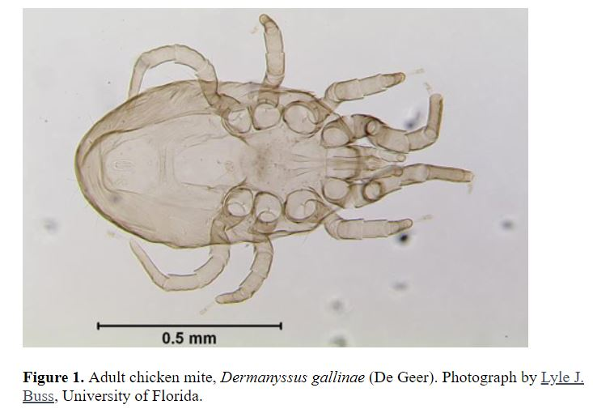
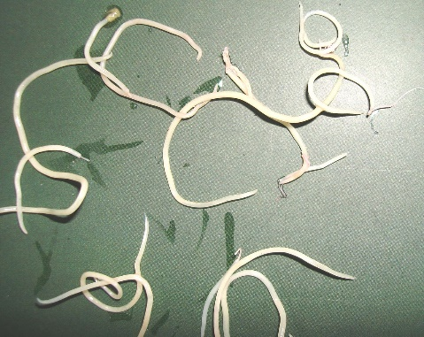
Poultry Parasites
Internal
Nematodes (roundworms)
Protozoa (coccidia)
External
Lice
Mites
http://entnemdept.ufl.edu/creatures/livestock/poultry/chicken_mite.htm
Ascarids. http://niagabastomi.blogspot.com/2016/06/obati-ayam-untuk-parasit-cacing-sebelum.html

Slide 12
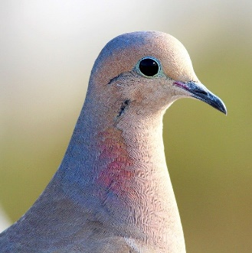
Signs of Illness
• General symptoms
– Ruffled feathers
– Weight loss
– Decreased appetite
– Drooping wings
– Depressed behavior
(pet birds)
– Failure to stand on
perches (pet birds
General signs
Ruffled feathers
Weight loss
Decreased appetite
Drooping wings
Depressed behavior
Failure to stand on perches
Digestive system
Diarrhea
Vomiting feed or water
Crop or gizzard impaction
Respiratory system
Sneezing
Coughing
Nasal discharge
Gasping for air
Labored breathing
Elevated respiratory rate

Slide 13
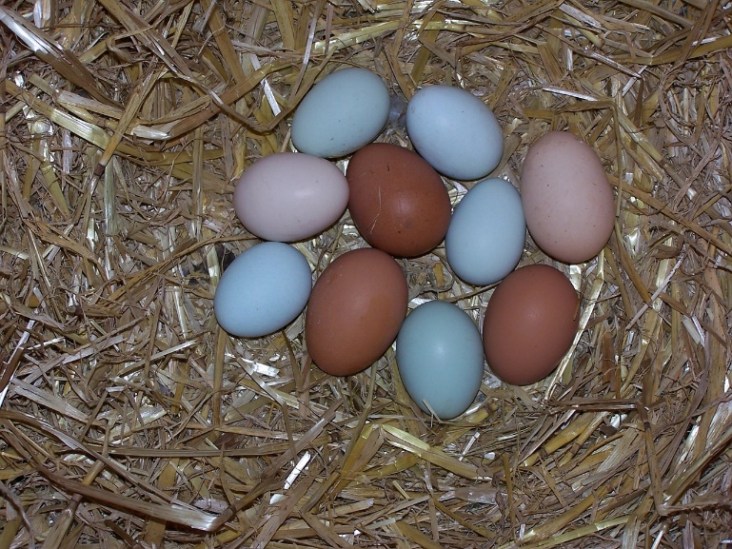
Signs of Illness
• General symptoms
– Ruffled feathers
– Weight loss
– Decreased appetite
– Drooping wings
– Depressed behavior
(pet birds)
– Failure to stand on
perches (pet birds
Reproductive system
Decreased egg production
Malformed eggs
Low fertility
Nervous system
Weakness
Circling
Muscle tremors
Severe depression
Twisting of head or neck
Lameness
Paralysis

Slide 14
The Disease Triad
k
Disease occurs when environmental, pathogen, and host factors align
To reduce the likelihood of disease, address each factor:
Increase host resistance
Correct environmental conditions promoting disease
Reduce pathogen exposure
PATHOGEN FACTORS
HOST FACTORS
ENVIRONMENTAL FACTORS

Slide 15
Increase Bird Resistance
Ensure proper nutrition
Provide adequate quantity and quality of food and water
Commercial diets more likely to meet birds’ needs
Monitor weight periodically
Feed pet birds more than just seeds– provide fruits, leafy vegetables, and sprouted seeds for a balanced diet
Give the proper diet for stage of life and production (e.g. layers)
Consult a veterinarian to discuss illnesses and treatments
Minimize bird stress

Slide 16
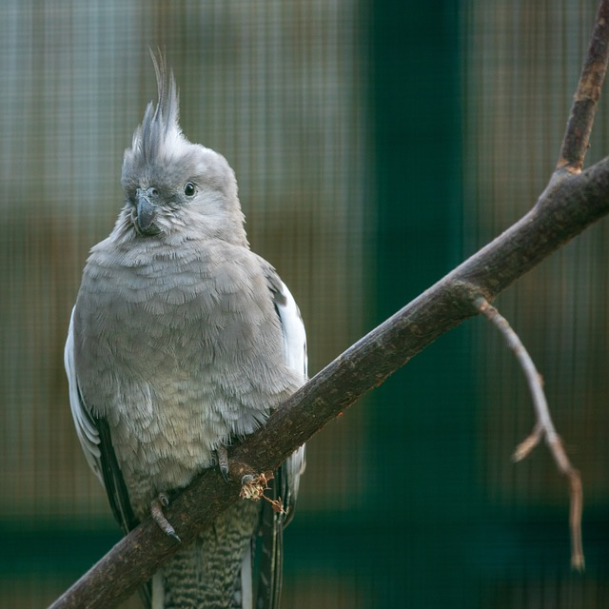
Minimize Bird Stress
Control predators
Control dust in pens
Minimize changes in bird groups
Limit visitors and caretaker changes
Prevent ammonia fume accumulation
Establish a clean and calm environment
Maintain proper temperature for bird comfort
Provide toys and enrichment activities for pet birds
Give birds adequate space, ventilation, shade, and nutrition

Slide 17
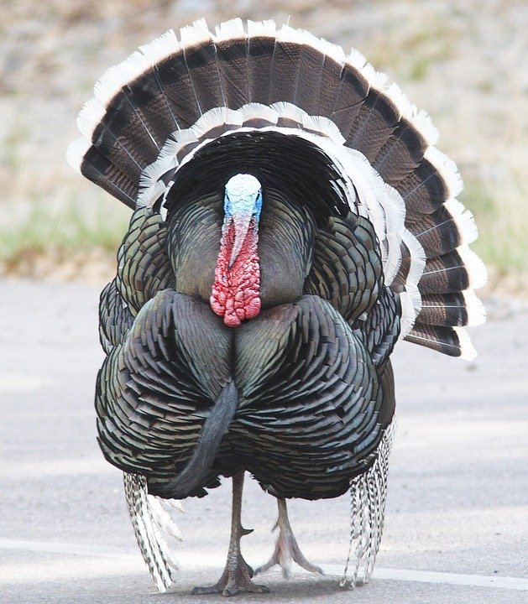
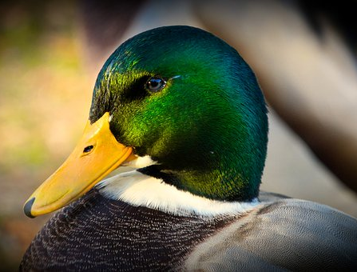
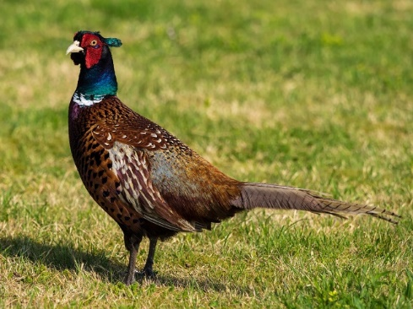
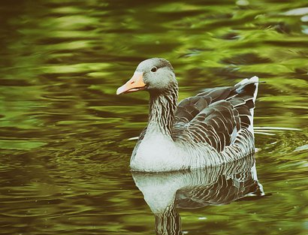
Reduce Environmental Factors
Provide excellent air quality via effective ventilation
Emphasize sanitary conditions to decrease exposure to pathogens
Prevent overcrowding
Protect birds and their environment from flooding and wetness
Maintain proper temperatures for bird comfort
Control flies, vermin, etc.
Prevent contact with wildlife and their habitat

Slide 18
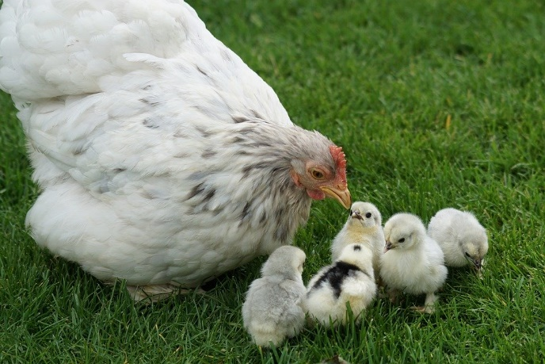
Reduce Pathogen Factors
Vaccinate to reduce impact of pathogens of concern
Clean and disinfect regularly to minimize pathogen concentrations
Keep a closed flock to prevent import of new pathogens
Quarantine new/returning birds for 30 d.; monitor for pathogens
Separate birds by age (older birds are a risk for younger birds)
Reduce pathogen dose and delay age of exposure so bird’s immune system is capable of responding and minimizing illness
Expose facilities and equipment to sunlight to kill pathogens

Slide 19
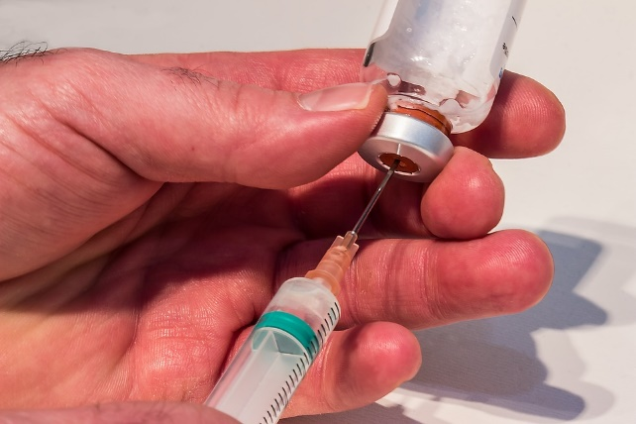
Medications and Vaccinations
Store medications and vaccines correctly
Check expiration dates and storage temperatures
Discard when expired
Follow instructions on vaccine or medication label
Vaccinate birds against diseases of concern in your area
Do not use unapproved medications without approval from your veterinarian
Antibiotics are not effective against viral diseases
Be aware of withholding times for meat and eggs

Slide 20
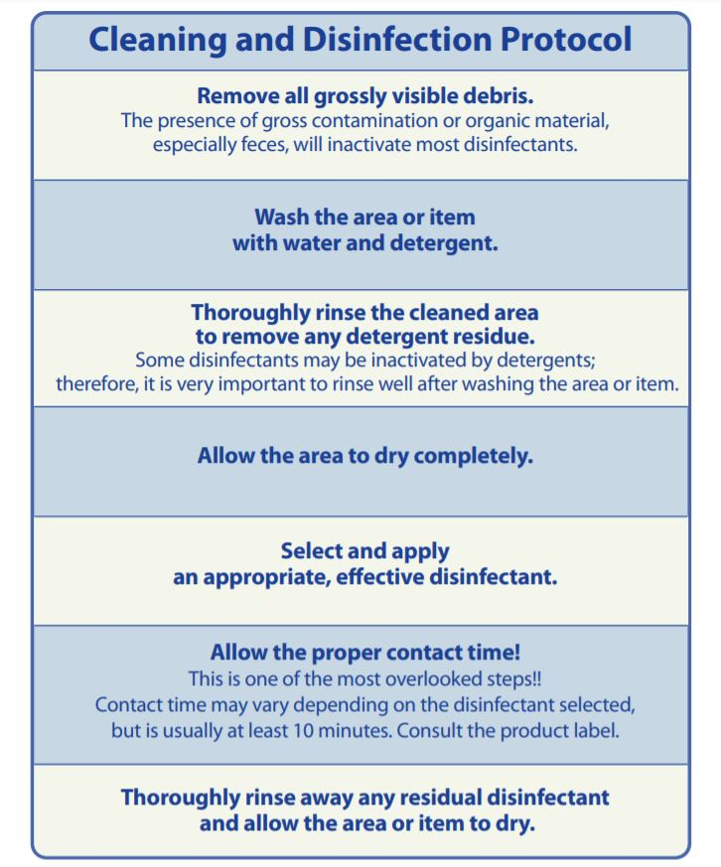
Cleaning and Disinfection
Cleaning means removing all visible debris (manure, bedding, dirt, feed, feathers, etc.)
Thoroughly clean all surfaces with soap and water
Rinse well and let dry if possible
Apply an appropriate disinfectant at the proper concentration for the recommended contact time
Rinse and let dry before using equipment or restocking premises with birds
www.cfsph.iastate.edu

Slide 21
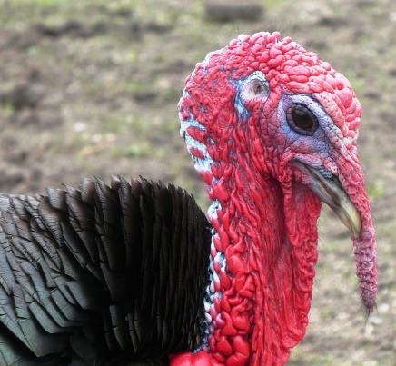
Biosecurity
Actions taken to reduce the introduction and spread of diseases on a farm
Emphasis on PREVENTION vs treatment
Benefits of Biosecurity:
Reduces pathogen numbers and likelihood of disease
Increases productivity and production
Decreases medication use, including antibiotics
Enhances reputation and flock value
Addresses animal welfare by reducing pain, sickness, and death

Slide 22
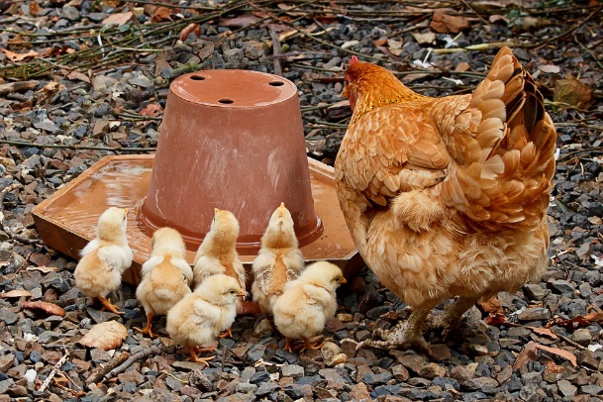
Biosecurity
Protect/separate birds from:
Wild waterfowl
Flies and rodents
Other animals
Visitors
If visitors have birds, do not let them near your birds
Quarantine new or returning birds for 30 days; watch for signs of illness
Isolate sick birds immediately; treat or euthanize as needed
If selling birds or eggs, meet customers off the farm
When possible, use surfaces able to be disinfected, instead of wood or dirt
Did you know: SUNSHINE is an excellent disinfecting agent

Slide 23
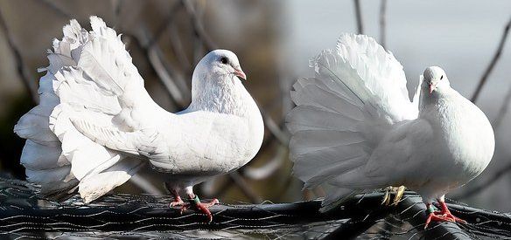
Biosecurity
Safest to keep a closed coop (no new birds, no visitors, no shows)
Before entering a bird area:
Wear clean clothes and disinfected footwear
Wash hands before handling birds and between bird groups
Clean and disinfect bird living area:
Remove old litter, manure, and all other visible debris
Clean surfaces with soap and water; rinse and let dry
Apply an effective disinfectant at recommended concentration for recommended contact time; rinse and let dry before returning birds

Slide 24
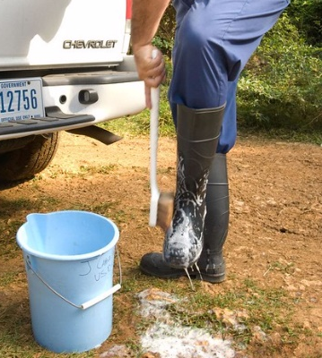
Biosecurity Steps
Use a hard roof or tarp to prevent wild birds from entering pen
Keep birds in a protected area; fence to prevent animals & people from entering
Minimize or exclude farm visitors
Vaccinate for diseases of concern
Keep wild waterfowl droppings out of coop
Prevent contamination of feed and water
If visitors come to your farm, provide boots or disposable booties
Clean and disinfect boots after use and/or dispose of disposable booties
Know signs of illness of various diseases & monitor birds closely
USDA APHIS

Slide 25
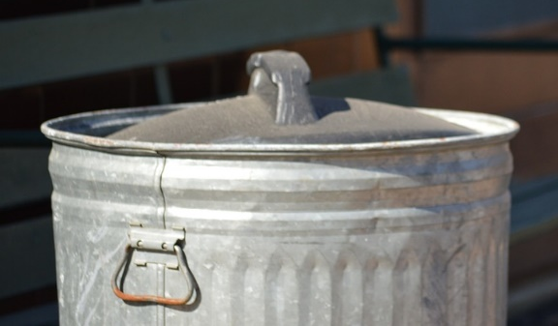
Biosecurity Steps continued
Clean & sanitize equipment & supplies properly
Wear coveralls or specific clothing when working with birds; launder after use
Work from youngest to oldest birds & from healthy to quarantined to sick
Eliminate brush, weeds, grass, & debris around pens to reduce vermin habitat
Keep feed in a sealed container to protect from pests & weather
Stir or rake bedding/litter so manure is even throughout & moisture absorbed
Ensure good sanitation through waste removal & cleaning
Thoroughly clean & disinfect poultry housing, equipment, tools, etc. to reduce carryover of disease-causing agents between groups of birds
Separate sick or dead birds from the flock immediately
Do not allow contact between sick humans and poultry
Do not house chickens with waterfowl or swine
Purchase birds from NPIP certified flocks

Slide 26
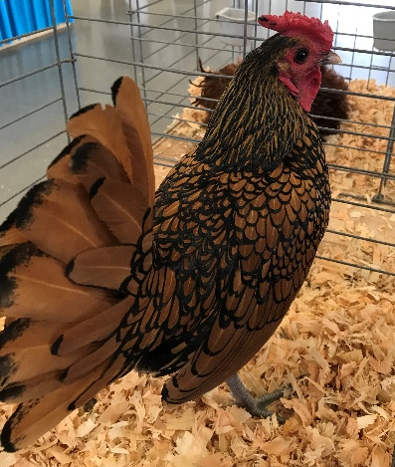
Biosecurity at an Exhibition
Broiler
– Hybrids or combinations of different breeds
• Developed for specific characteristics
– Grow faster and larger
– Large breast meat yield
– More efficient feed conversion
– More disease resistance
• Used by commercial broiler producing companies
• Weakness: Do not lay as many eggs as layer breeds
Don’t borrow equipment and supplies from other bird owners unless thoroughly cleaned and disinfected before and after use
Disinfect hands before and after handling someone else's birds
Provide solid barriers between birds from different premises
Use a clean holding towel and carpet square for each bird
Sterilize grooming instruments before and after each use
Quarantine birds returning from a show for 30 days
Do not allow direct contact between birds
House waterfowl and poultry separately
Consider wearing disposable gloves
Do not house birds with swine

Slide 27
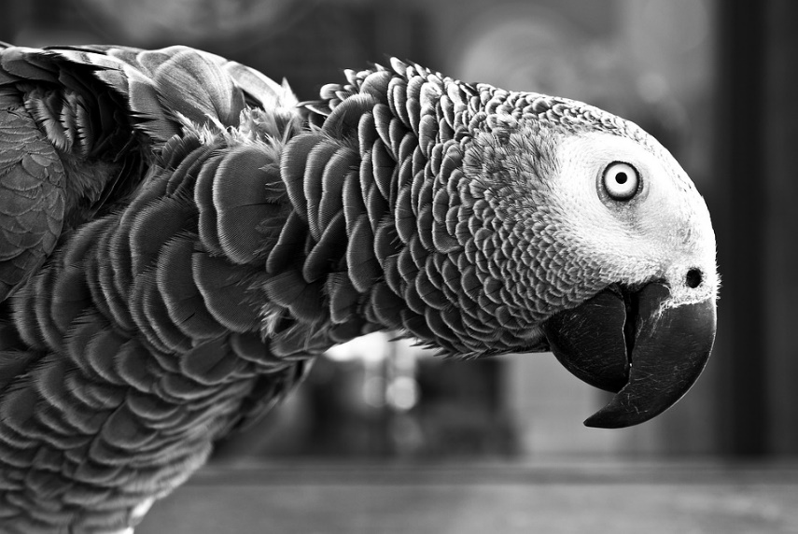
Biosecurity for Pet Stores
• Have customers wash hands before and after handling birds
• Display birds behind glass barriers to prevent exposure to people carrying germs
• Employees must wear clean clothes each day and wash hands before and after handling birds
• Best if employees do not also own pet birds or poultry

Slide 28
Resources
WSDA Avian Health Program https://agr.wa.gov/departments/animals-livestock-and-pets/avian-health
USDA Avian Health https://www.aphis.usda.gov/aphis/ourfocus/animalhealth/animal-disease-information/avian and https://www.aphis.usda.gov/aphis/ourfocus/animalhealth/animal-disease-information/avian/defend-the-flock-program
WADDL Avian Health and Food Safety Laboratory, Puyallup https://waddl.vetmed.wsu.edu/avian
Extension Small and Backyard Poultry https://poultry.extension.org
Poultryhub.org http://www.poultryhub.org/
U.S. Poultry and Egg Association https://www.uspoultry.org/
Biosecurity and Disinfection www.cfsph.iastate.edu

Slide 29
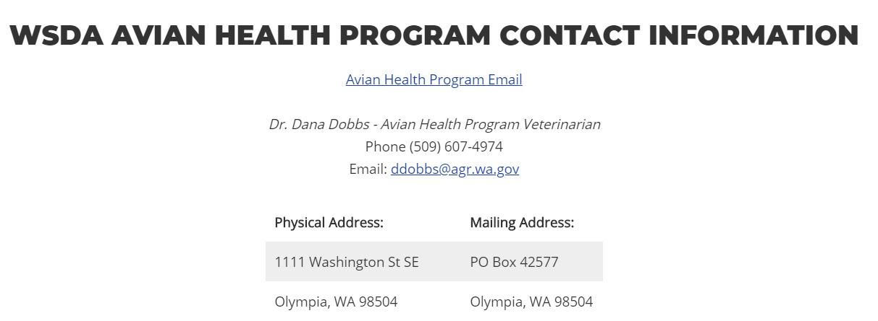
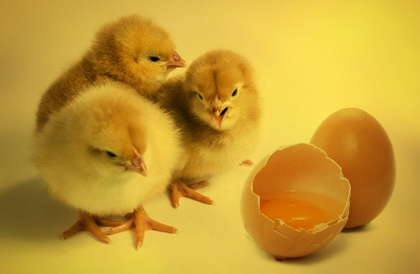
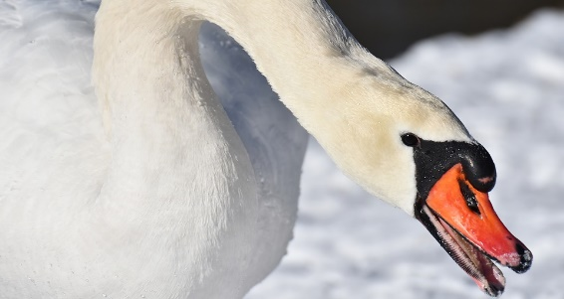
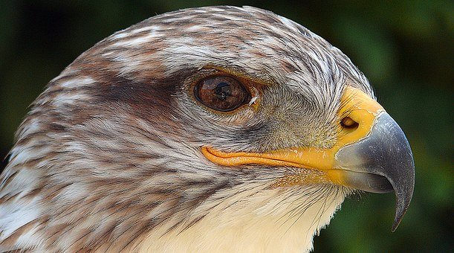
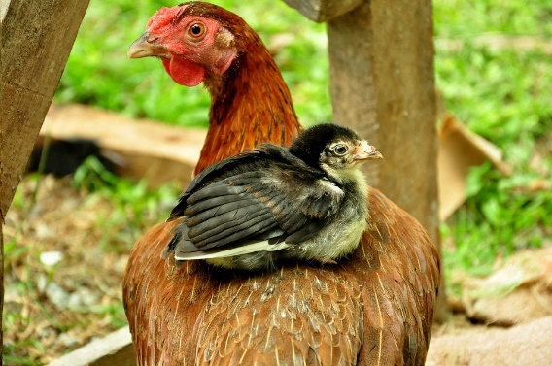
WSDA Avian Health Program Contact Info
avhealth@agr.wa.gov

Slide 30


Contact WSDA
WEB
EMAIL
agr.wa.gov
ahealth@agr.wa.gov
TWITTER
FACEBOOK
@WSDAgov
http://tinyurl.com/WSDAFB
PHONE
YOUTUBE
360-902-1878
Youtube.com/user/WSDAgov
Images used in this presentation may not be reused without explicit written permission from the WSDA Communications Office

